Slide 1
The Colwood Proposal
Tertiary Sewage Treatment and Resource Recovery

Slide 2
Proposed Amendment
Support for an Amendment (10) to the CALWMP – very similar to Amendment 7 (i.e., tertiary in WestShore built at same time as main plant
This is not a final decision, simply approval in principle that allows Colwood to fully explore this approach

Slide 3
Next Steps if approved in principle…
Amendment Process
Grant agreement secured
Public consultation throughout Core area
CRD Board approval to request amendment from Ministry of Environment
Colwood pays all costs
Approved amendment from Ministry of Environment
Detailed study and design
Environmental Impact Studies
Groundwater studies
Colwood pays all costs
Develop best financial model
Ministry of Environment prepared to approve Operating Certificate

Slide 4
Colwood Facility Benefits
Tertiary disinfected
Short term – treated water to ground
Longer term – water reuse for irrigation, toilet flushing, ground and creek enhancement
Heat recovery to local buildings
Biosolids dried, used as fuel

Slide 5
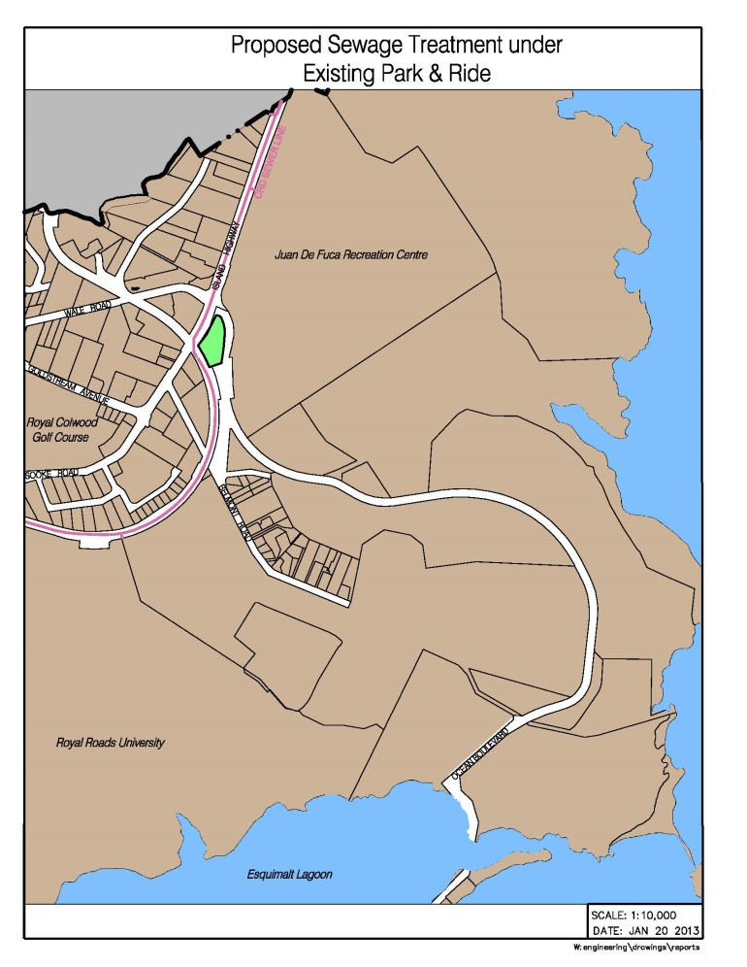
Proposed Location: Under Westshore Park & Ride

Slide 6
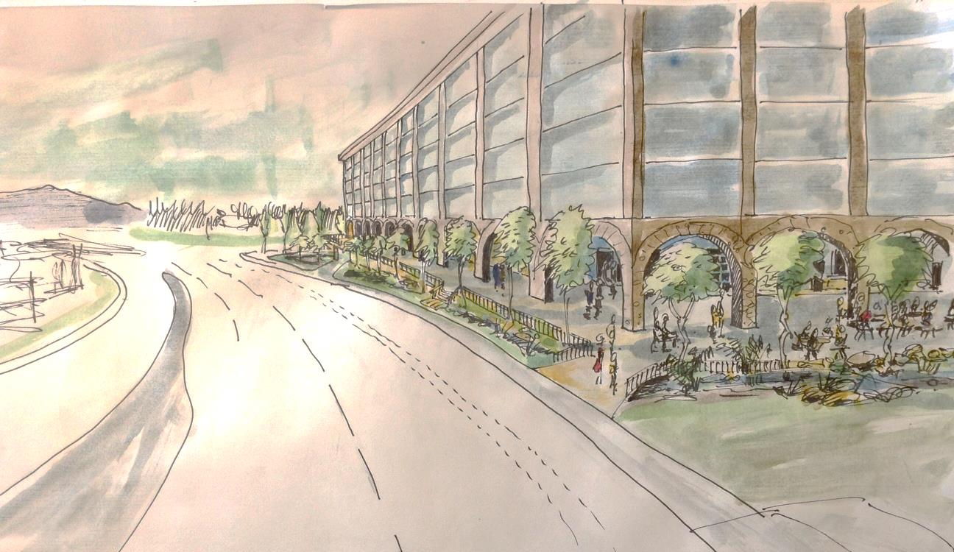
Vision for a Colwood Resource Recovery Centre

Slide 7
Financial Implications
No change to design of main plant – adds 4-5 years capacity for other core municipalities
Modest short term cost to other municipalities – about $16 per household per year, BUT
avoided future cost of about $250 per year for WestShore plant
Colwood is not seeking to have its ‘share’ of the federal/provincial grants
Colwood will leave $ already contributed

Slide 8
Sewage Treatment Financial Timeline

